Slide 1


MusicAdventure

Slide 2




the enemies
The player
Moving platforms
Platforms

Slide 3



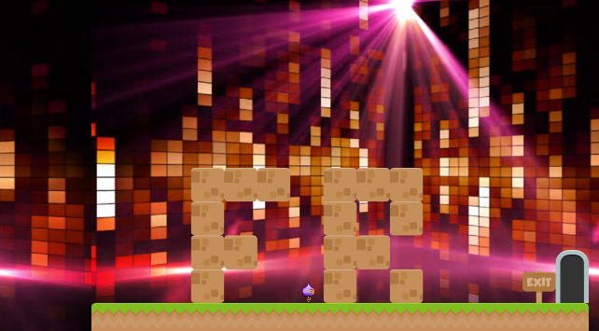
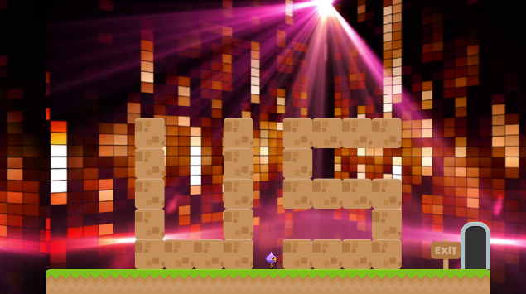
Chapter 1: 5 levels
Chapter 2: 4 levels
Chapter 3: 4 levels (with FR & US level)

